Slide 1
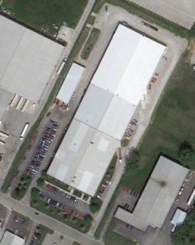
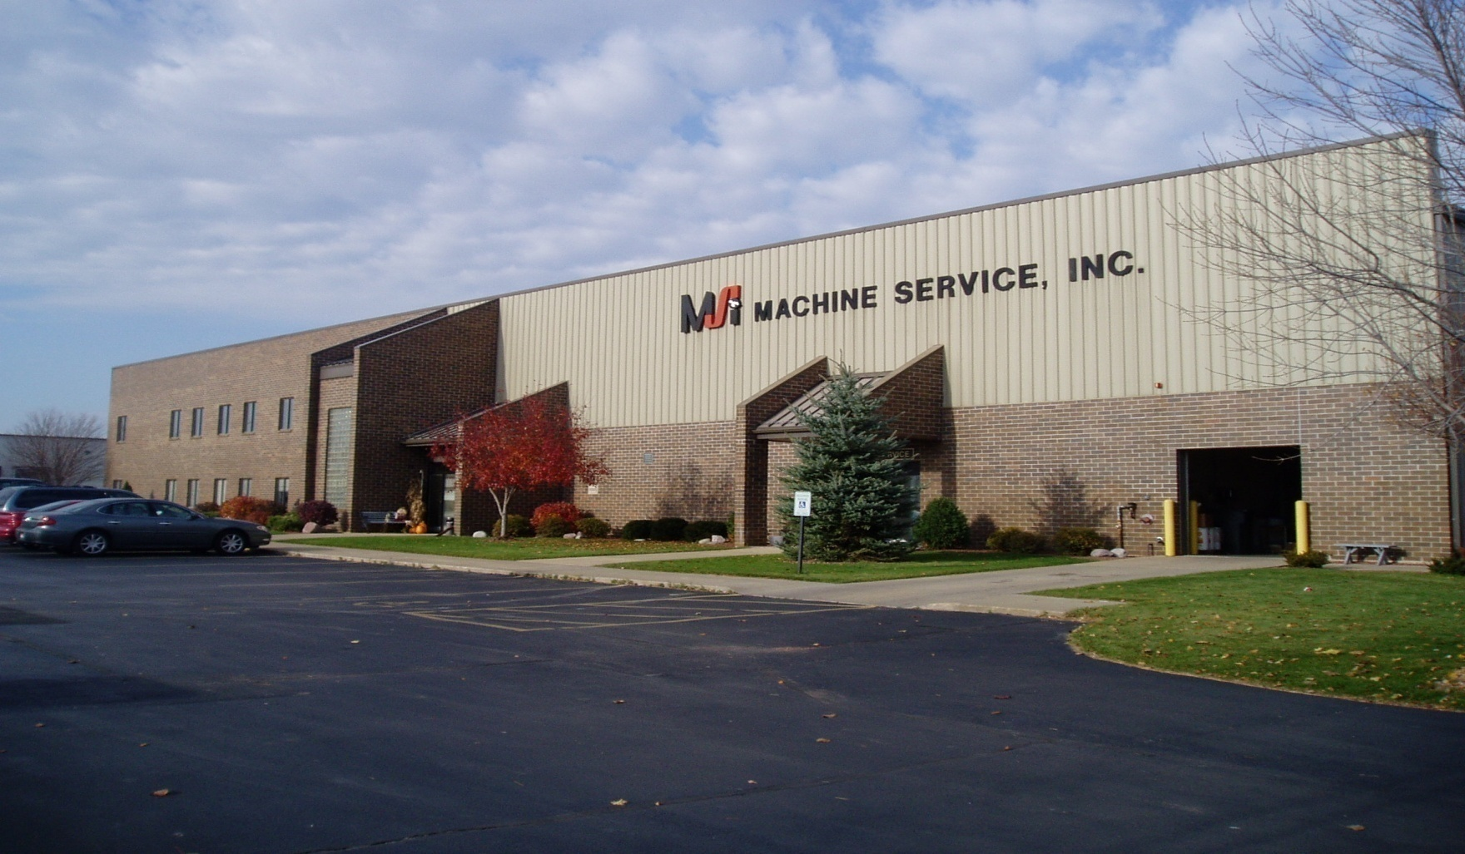
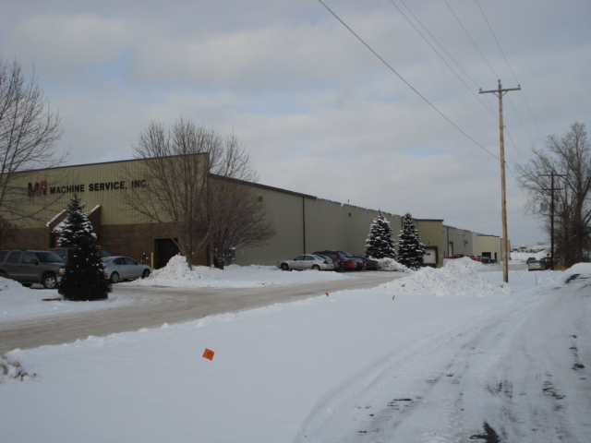
MACHINE SERVICE, INC

Slide 2
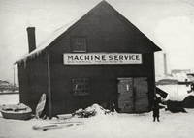
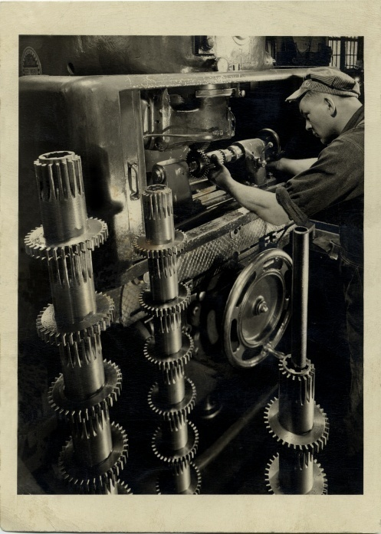
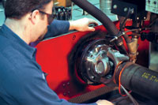
The History
Family business since 1948 in Green Bay, WI
First established near the Fox River in an old fishing garage
Building with a size of 135,000 square feet finished in 2008
300 employees
Annual sales $80-90 million
Manufacture over 150,000 drive shafts per year
135,000 sq. ft. in Green Bay, WI
Offices in:
Michigan
Minnesota
New York
South Carolina
Wisconsin

Slide 3
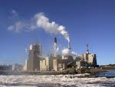
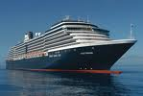
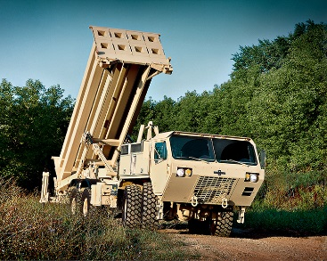
Multiple Industries Served

Slide 4
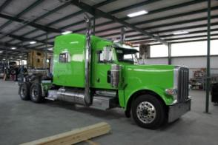
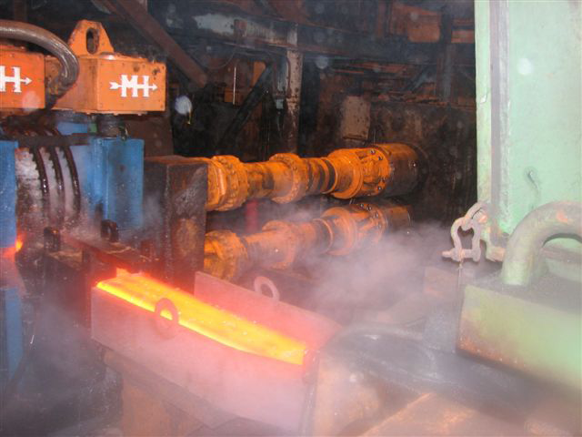
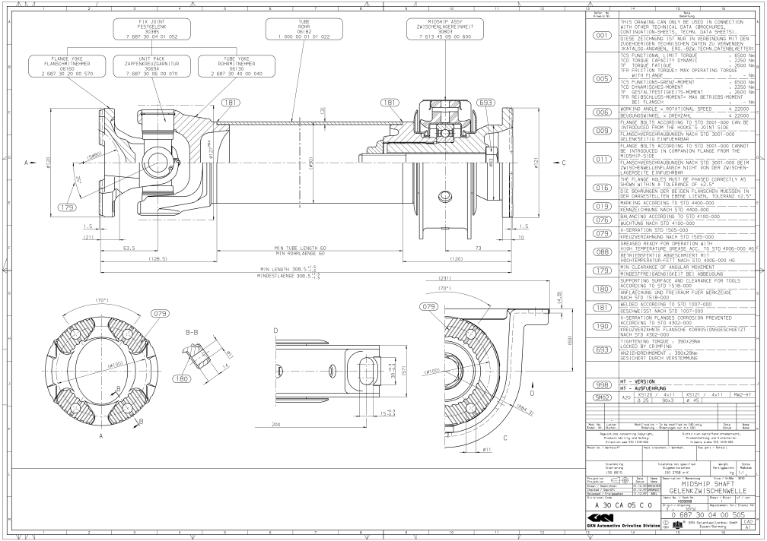
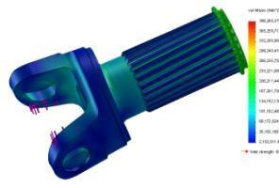
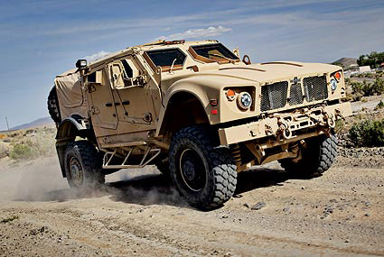
Custom Engineering:
Engineering Department with over 40 years of knowledge and experience for any application
Latest CAD, 3D Modeling, and Simulation Software
Complete Engineering Assistance Available In-House:
Bearing Life, Stress Calculations, Testing Certifications, etc.

Slide 5
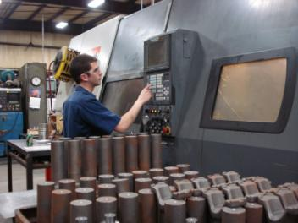
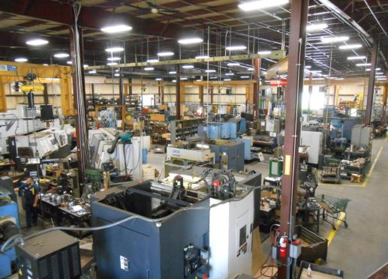
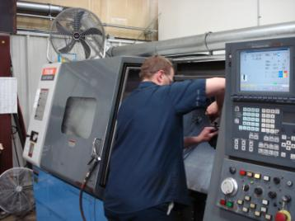
Machine Shop:
Continually Updated Machine Shop Including:
Turning
Milling
Broaching
Keyseat
Shaping
Hobbing Machines
CNC Turning & Machining Centers customized for your needs from 2” to 40” diameter

Slide 6
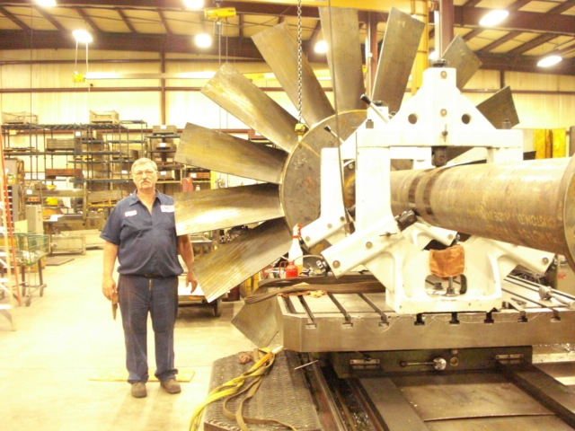
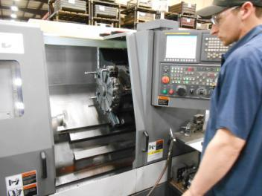
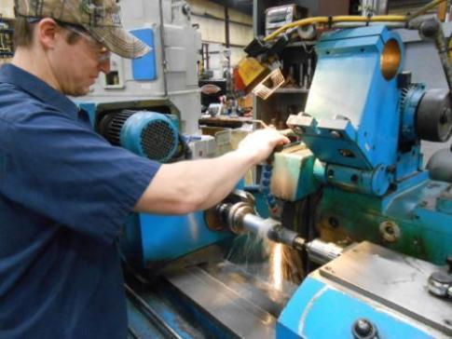
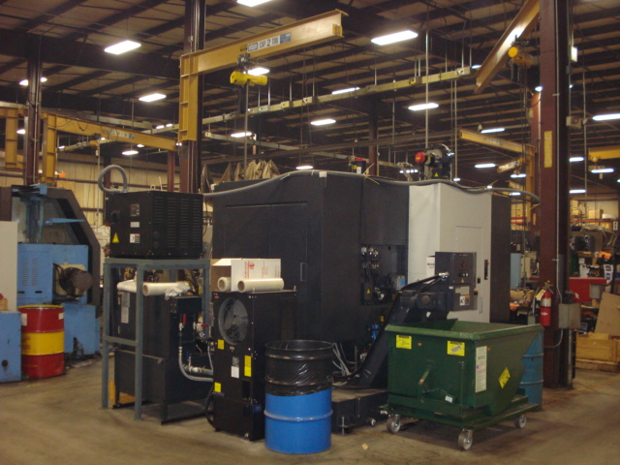
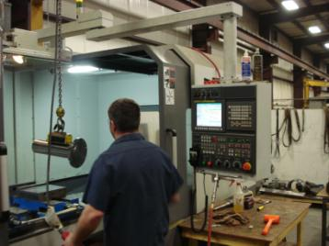
Machine Shop:
CNC brands such as OKK, Mazak and Samsung are used to produce precision parts of the highest quality

Slide 7
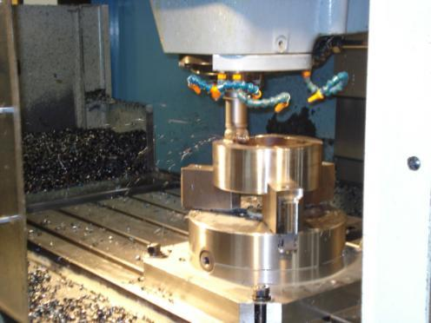
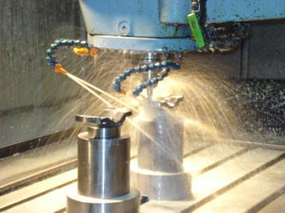
Machine Shop:
Our on-site capabilities include the production of:
Yokes
Splines
Companion Flanges
Other Custom Machined Parts

Slide 8
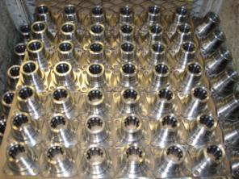
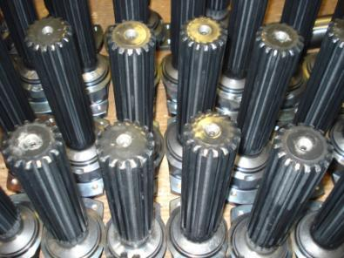
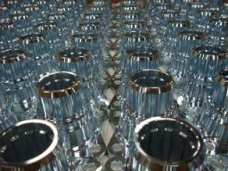
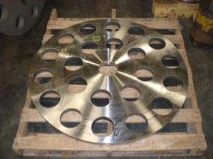
Machine Shop:
Parts produced are manufactured and inspected by skilled technicians to the highest standards of quality in industry today

Slide 9
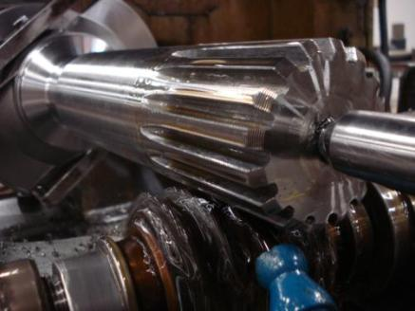
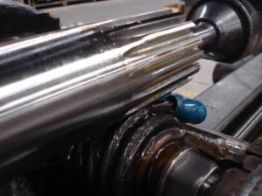
Machine Shop:
Internal and external spline cutting according to SAE and DIN standards
Custom hubs and yokes up to 36” diameter
Custom spline sets up to 16” diameter

Slide 10
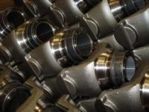
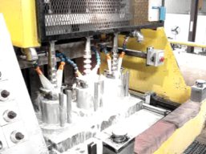
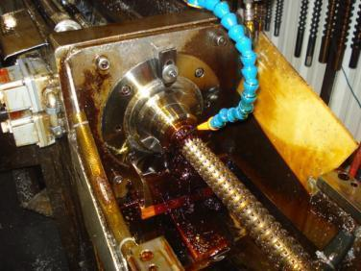
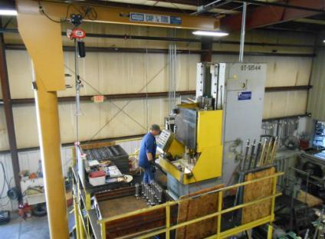
Machine Shop: Broaching
High volume broaching machines for efficient parts production
All common PTO, pump, and transmission splines can be manufactured competitively

Slide 11
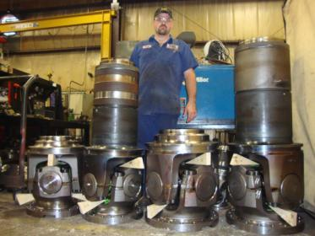
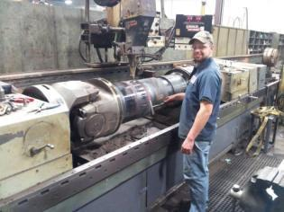
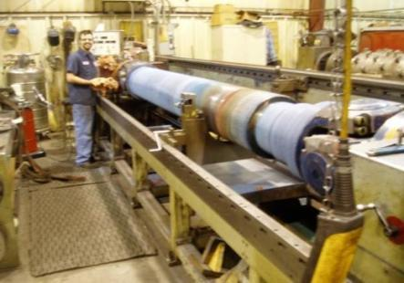
Driveline Manufacturing:
Universal shafts and couplings
Up to a 40” swing diameter and a length of up to 25’
24 hour emergency service
Rebuild and repairs with quick turnaround

Slide 12
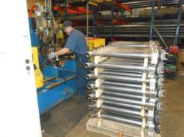
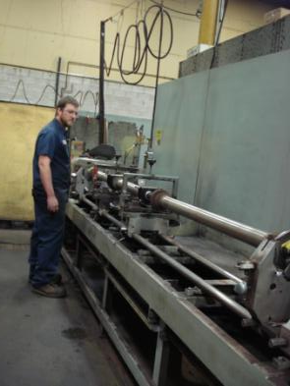
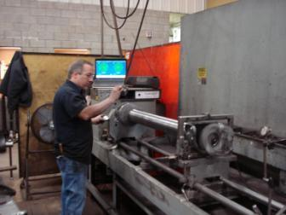
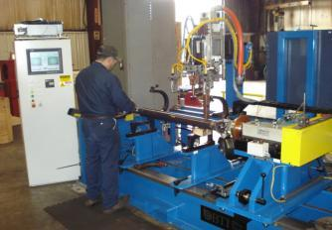
Driveline Manufacturing:
Balancing:
all computerized
speeds of up to 10,000 RPM

Slide 13
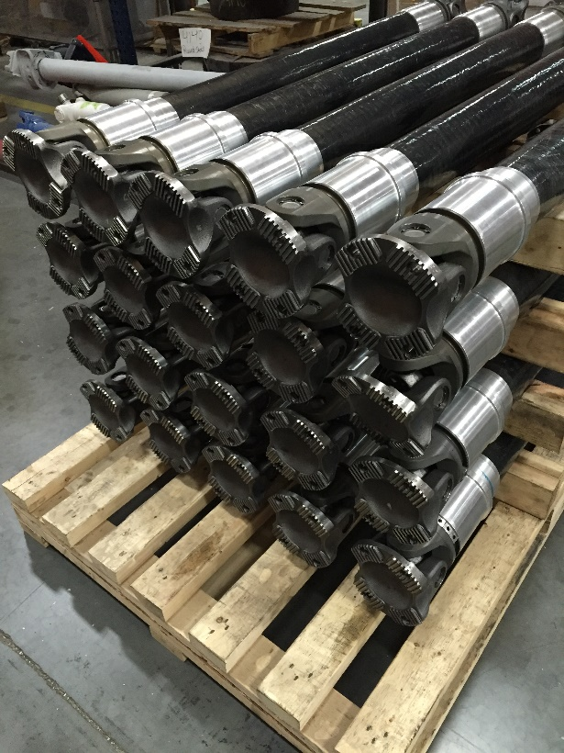
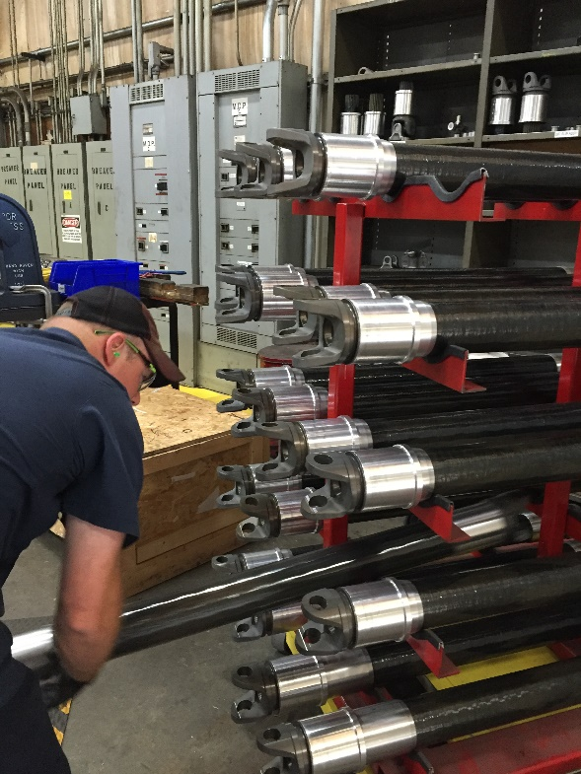
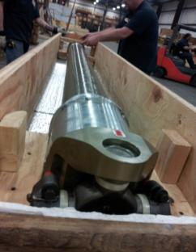
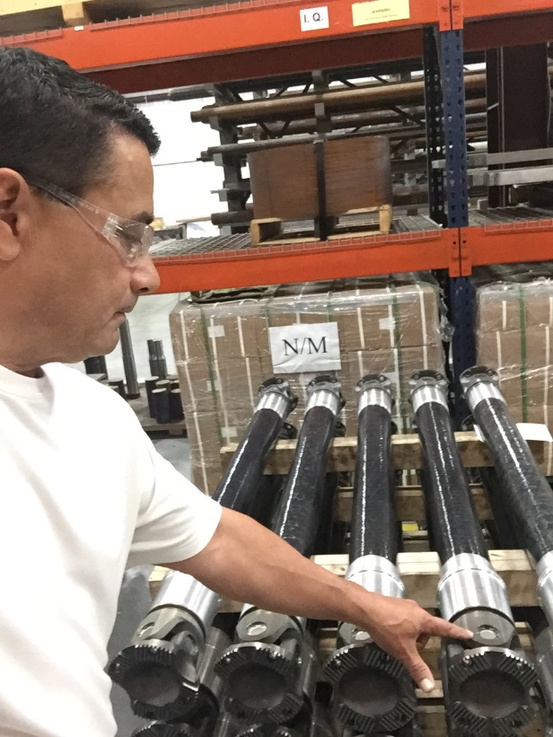
Specialties: Hybrid Composite Shafts
Carbon-Fiber tubing and aluminum components
Up to 70% weight reduction compared to conventional steel shafts
Lightweight, vibration-dampening, higher critical speed
Patented technology

Slide 14
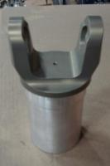
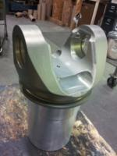
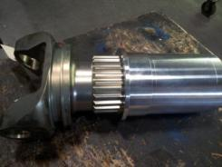
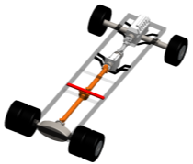
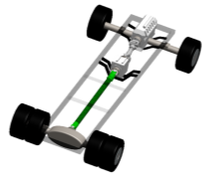
Specialties: Hybrid Composite Shafts
Available for most joint sizes and styles
Great for all applications that need light weight shafts and high efficiencies eg:
Marine
Commercial truck
Specialty vehicles
Industrial applications (such as vertical pumps, paper mills, etc)
Replaced With
Two-Piece Steel Shaft
Composites - Click Here
One Hybrid
Composite Shaft

Slide 15
Specialties: Marine Drivelines
Cardan or CV joints available as standard steel or hybrid composites
ABS, Lloyd’s, and other certifications available for rebuilds and new applications

Slide 16
Specialties: Levelers/Steel Mills
Custom designs for small swing diameter and high torque
Special quick-disconnect hubs and end fittings
Long slip and high angle designs

Slide 17
Specialties:
Efficient Solutions For The Oil and Natural Gas Industry
Highest quality, brand name recognition, and solid engineering are our standards as the market leader
Standard DIN flange connections as well as SAE and other patterns
Companion flanges are available for all sizes
Fracturing - Click here
Drilling

Slide 18
Production:
From one piece to 10,000 pieces
From 1” to 1000 mm
From rigid steel shafts to torsional soft Iso-Tec shafts - Click Here
We are committed to serving the needs of our customers

Slide 19
Shipping and Receiving:
Our shipping department will make sure that your shipment gets to where it needs to be in one piece and on time
Our receiving inspection is the first part of our quality control

Slide 20
Inspection and Quality:

Slide 21
Contact:
Sales Offices
Manufacturing Locations:
Green Bay, WI
1000 Ashwaubenon St.
Green Bay, WI 54304
(920) 339-3000
Fax (920) 339-3001
800-677-8711
Minneapolis, MN
5208 Bloomington Avenue So.
Minneapolis, MN 55417
(612) 824-6548
Fax (612) 824-6634
800-677-8711
Baldwinsville, NY
8762 Foxfire Lane
Baldwinsville, NY 13027
(315) 638-7644
Fax (315) 638-7604
800-701-8432
Detroit, MI
9304 Allen Road
Allen Park, MI 48101
(313) 388-7166
Fax (313) 388-6721
Corporate Office
Green Bay, WI 1000 Ashwaubenon St. Green Bay, WI 54304 (920) 339-3000 Fax (920) 339-3001 800-677-8711
Greenville, SC
9454 Old White Horse Road
Greenville, SC 29617
(864) 252-4588
Waukesha, WI W229 N1823 Westwood Dr. Waukesha, WI 53186 (262) 521-3234 Fax (262) 521-3114 800-242-2115
Website
Email Contacts
www.machineservice.com
www.machineservice.com/our-staff/

